Slide 1
Project 1 : A Pedestrian Alert System using “earables”
Team Member: Xuchen Xue

Slide 2
Overall Project Goals and Specific Aims
Use the audio information to recognize the approaching cars and their direction
Record audio information with two phones and two microphone and analyze audio files offline
Extract the IMU information to determine the position of user’s head
Design a Android app to show the position of user’s head in real-time with information extracted from eSense earables IMU unit
A mechanism to alert the user if user is not aware of the approaching vehicle
Combine previous information and propose a possible mechanism to alert user of unseen approaching cars

Slide 3
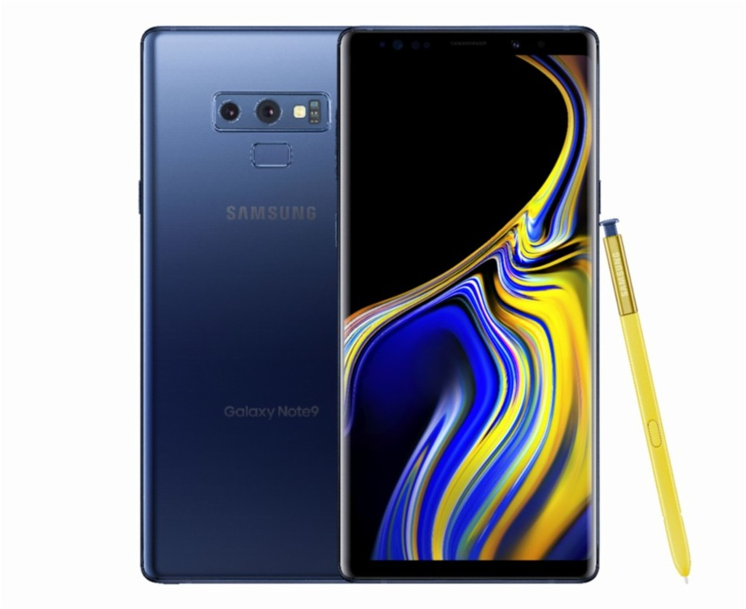

Technical Approach - Hardware Setup
Since we choose to analyze audio file offline, we only need two microphones and two recording devices to record stereo sound
In this project, we choose two mobile phones as our recording devices
We choose 44 KHz (CD quality) to be our sample rate to increase number of samples in a single frame
Synchronization became a critical problem since the latency between two microphones is really small
A small error in synchronization could lead result error since the speed of sound is fast
We use a tone generator to generate a 1kHz tone (car noise frequency is typically around 200 Hz) while recording audio samples to achieve synchronization.
Samsung Note 9
Google Pixel 2

Slide 4
Technical Approach - Sample Collection
We record our sample at campus garage (want to record positive samples with minimum noise)
The distance between two microphones is approximately one meter
Car is approximately 30 meters from the recorder

Slide 5
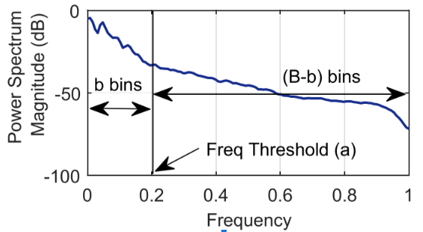
Technical Approach - Feature
Feature: Non-Uniform Binned Integral Periodogram (NBIP)
Equally divides the frequency scale in order to capture variation in spectral energy at the lower end of the frequency spectrum which characterizes the car noise so that we set b to be a large number to represent more information on this range.
Finally, we can get a B dimension feature vector which we use in classification.
B = 20, b = 18, Frequency Threshold = 0.3*44100/2 = 6.6kHz

Slide 6

Technical Approach - Feature
Computation procedure:
Step 1: The FFT of each audio frame x(t) is computed to obtain the Fourier spectra X(f). Only the left half of this symmetric spectra is retained.
Step 2: The periodogram of x(t) is obtained from X(f) by normalizing its magnitude squared, and then taking its algorithm.
Fs and N denote the sampling frequency and the signal length, respectively.

Slide 7
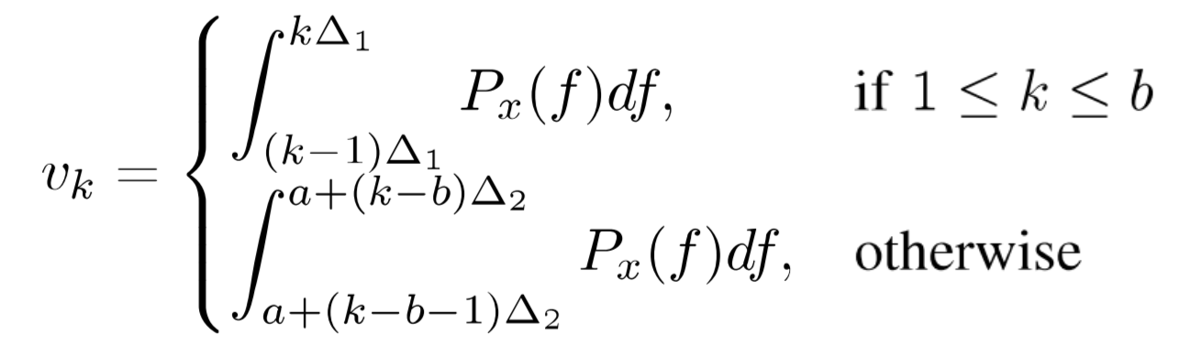


Technical Approach - Feature
Step 3: The frequency range is divided into a total of B bins, such that the frequencies below a threshold a are equally divided into b bins, and the higher frequencies are equally divided into B-b bins. The parameters B, a and b are empirically determined and here we use the parameters in [1].
Step 4: The Px(f) is integrated in each bin to obtain a B dimension feature vector v = (v1, v2 …, vB)

Slide 8
Technical Approach - Frame Choosing
In this project we choose 100 ms as our time frame
We compare different time frame of 20 ms , 50 ms, 100 ms and 200 ms and we found 100 ms is optimal since it contains enough useful information and short than 200 ms.
We choose 2 ms as our slide window so window overlap is 98%
In original article, research team use 50 ms of slide window. It won’t work in our situation since the time difference we are detecting are just few milliseconds
The disadvantage of small slide window is large number of computation

Slide 9
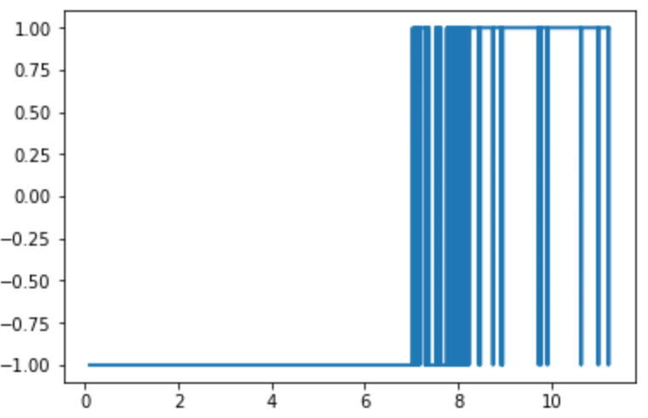
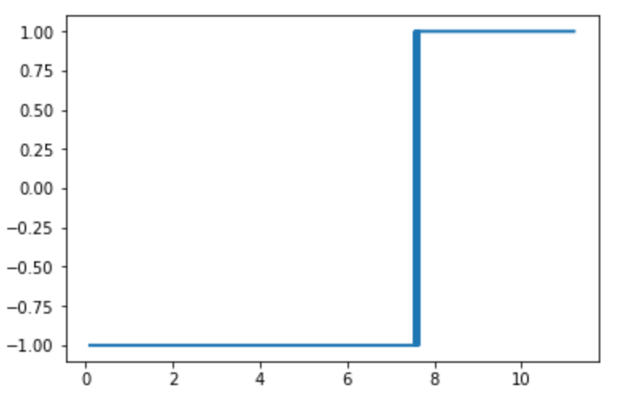
Implementation - Model Training
Model: OneClassSVM Isolation Forest
Test:

Slide 10
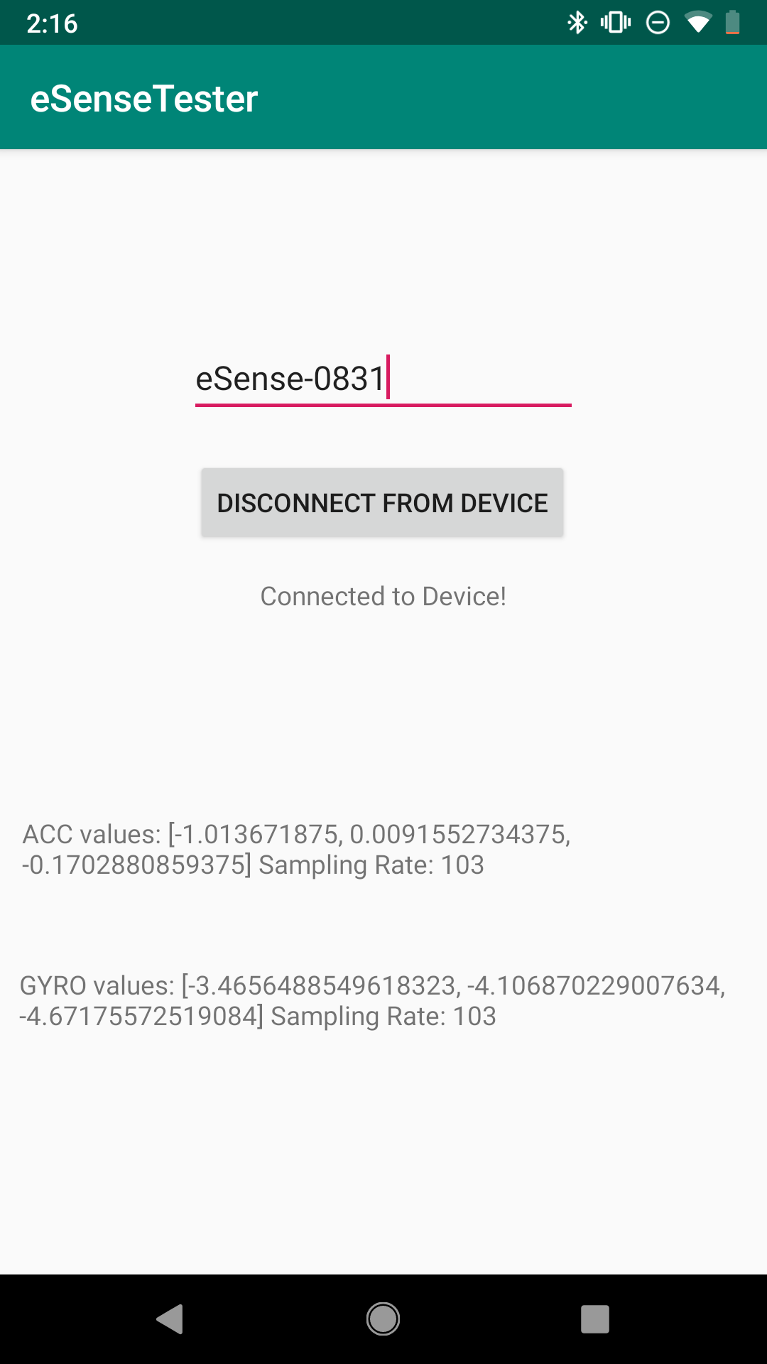
Implementation - eSense IMU
In this project, we also use the information of eSense IMU to determine the position of head
We use a program provided by Brian Wang to extract IMU information
The program only provide angular acceleration information (degree/S) with sample rate around 85 samples/second (depend on the distance between eSense earable and mobile phone)
Need to do integration over time to get head position
Since the large time frame and heavy noise on IMU unit, result might not be accurate

Slide 11
Proposed Alert Mechanism (Ideal)
Extract information from eSense IMU and determine the position of head
If your head is toward front, we deactivate the alert system to save power
If you are lowering your head, we assume you are using your phone and activate alert system
Using the microphone of eSense earables or other device to collect stereo channel information and send it to user’s mobile to perform real-time noise detection
Once car noise detected, perform direction detection and send alert to user’s phone

Slide 12
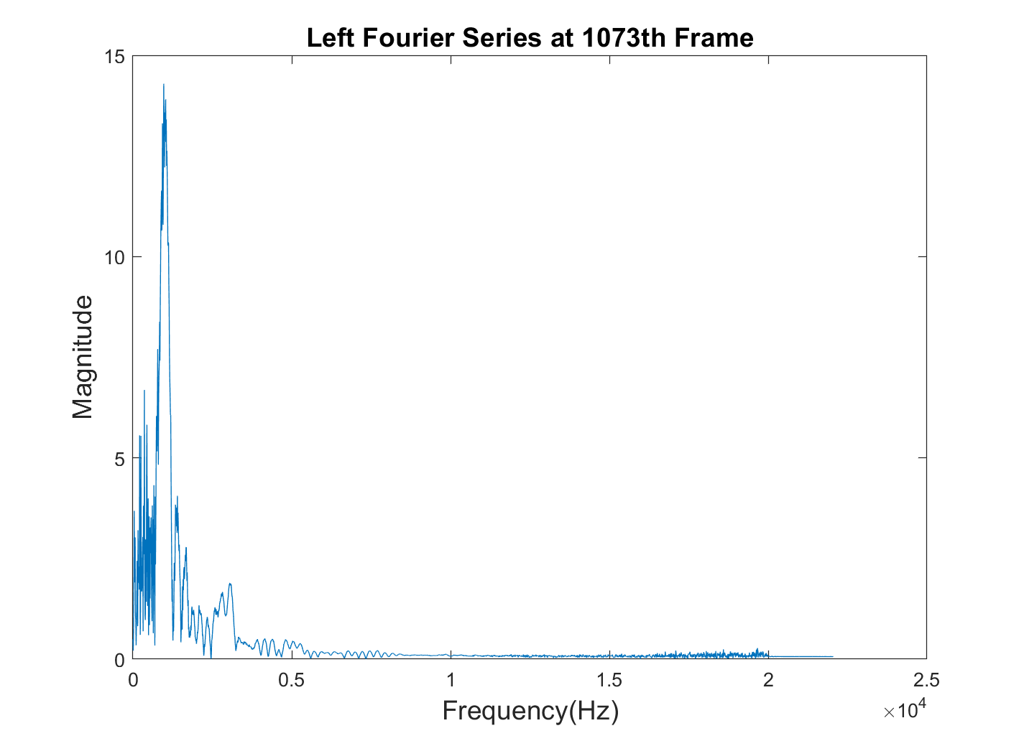
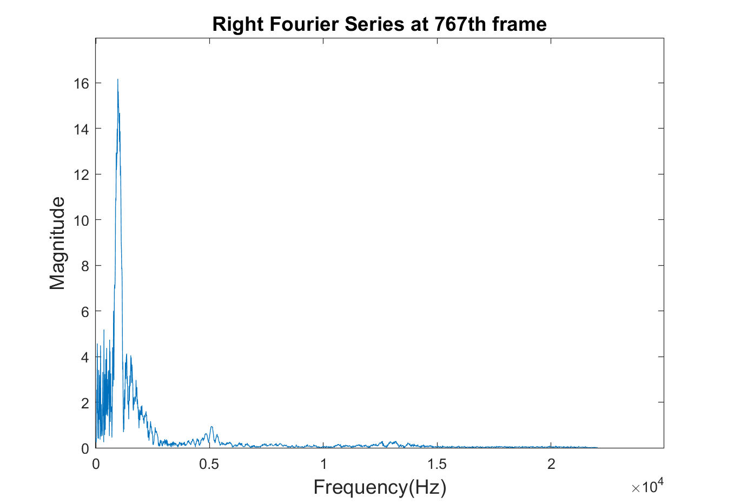
Experimental Evaluation
Dt = (1073-767)*T_slide = 0.555102s
Notes:
Syncronization

Slide 13
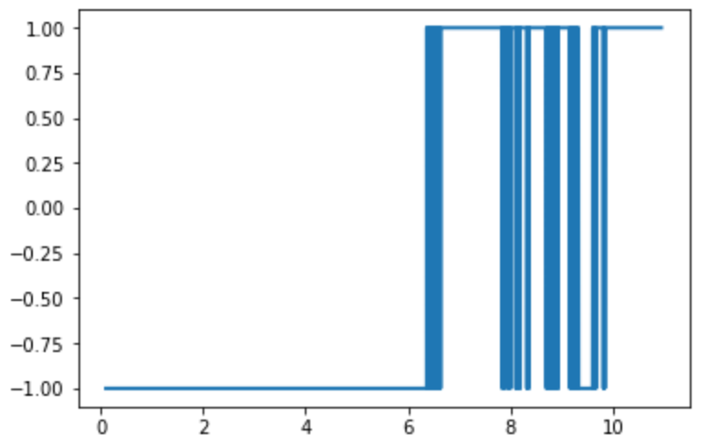
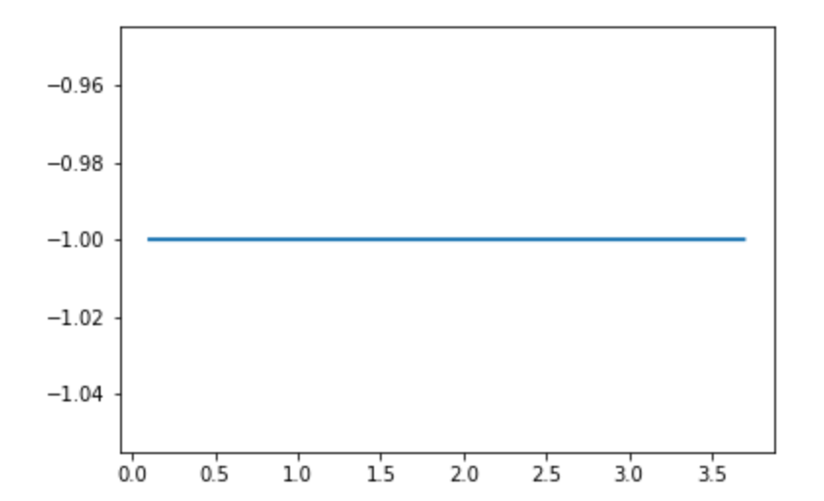
Experimental Evaluation
Sample with Car Noise Sample with Random Noise

Slide 14
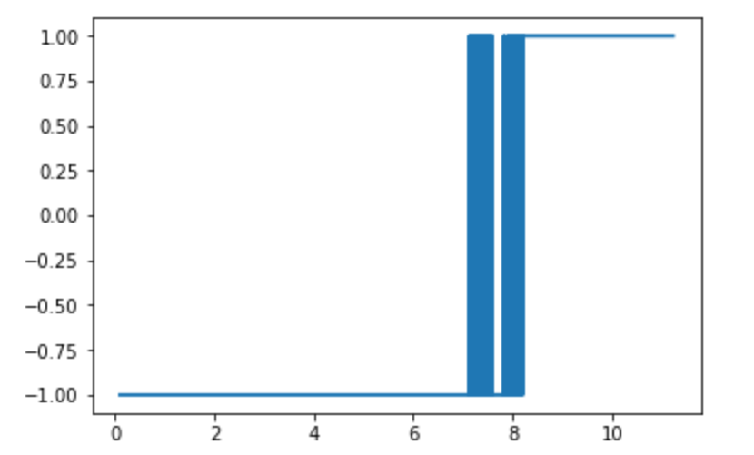
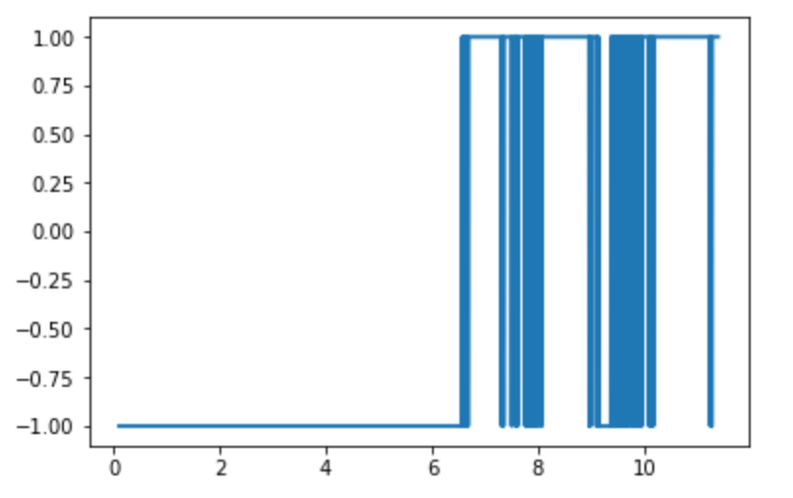
Experimental Evaluation
Left detection
Right detection

Slide 15
Experimental Evaluation
Apply the detection on each channel and record the time that car noise first appears.
In this case, relative delay is (3904-3602)*T_slide = 0.5478458s
The final result is 0.555102 - 0.547846 = 0.007526s
Right comes first, which means car is on the right hand side, consistent with our sample

Slide 16
Remain Steps
Collect more samples to train the model and use more test cases to test the robustness of this system
Complete final report and upload everything on GitHub

Slide 17
Strengths and Weakness
Strength:
Since the purpose of this project is to alert user of unseen approaching cars and the human eye diopter of two eyes is approximate 188 degrees, the angle accuracy of angle for this for this project is not strict. With this reason, we could cut the number of microphone from 4 to 2 which could make the device more portable in the future.
Weakness:
Since we only has two microphones, we can’t tell if the car come from front or back
Need to transfer this offline analysis into real-time real-time analysis in the future. Large number of computation could be a potential problem.

Slide 18
Future Direction
When train the model, input the noise of various of car models and under various circumstance to improve the robustness of the system
Modify model parameter (such as frequency threshold, frame size , slide size, etc.)
Design a board with microcontroller which can take two input simultaneously with good synchronization property and send stereo audio files to mobile phone in real-time.
Design robust common filter to filter out the noise of eSense IMU unit and improve the accuracy of determining user’s head position (or switch to different devices)

Slide 19
Reference
[1] de Godoy, D., Islam, B., Xia, S., Islam, M. T., Chandrasekaran, R., Chen, Y. C., ... & Jiang, X. (2018, April). Paws: A wearable acoustic system for pedestrian safety. In 2018 IEEE/ACM Third International Conference on Internet-of-Things Design and Implementation (IoTDI) (pp. 237-248). IEEE.
[2] S. Xia et al., "A Smartphone-Based System for Improving Pedestrian Safety," 2018 IEEE Vehicular Networking Conference (VNC), Taipei, Taiwan, 2018, pp. 1-2.

